Slide 1
Model predictive control
Prof. Davide M. Raimondo
Università degli Studi di Pavia
davide.raimondo@unipv.it

Slide 2
HYBRID MPC

Slide 3
HYBRID Model predictive control
We consider system consisting of
continuous dynamics : described by one or more difference (or differential) equations, states
belong to a continuum
discrete events: state variables assume discrete values from a countable set, e.g.
binary digits {0, 1},
N, Z, . . .
finite set of symbols
Hybrid systems: system whose evolution depends on both continuous dynamics and discrete events.
Examples: systems with switches, valves, mechanical systems, computer programs etc.

Slide 4
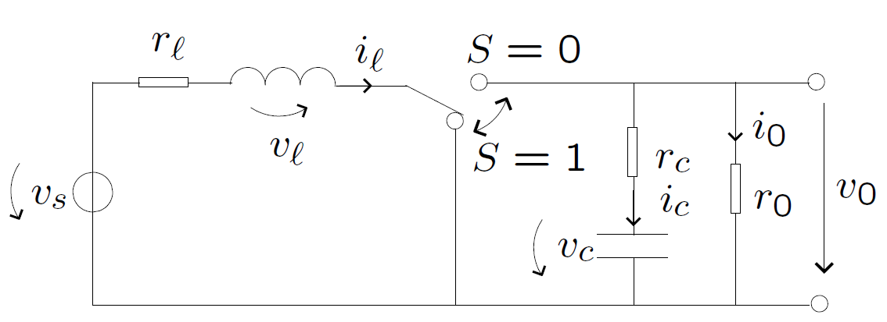

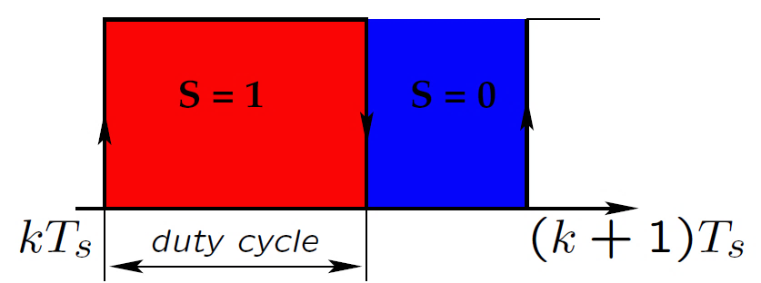
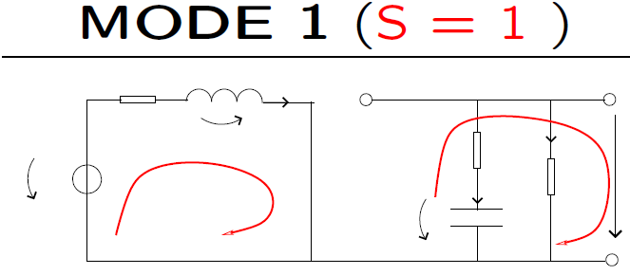
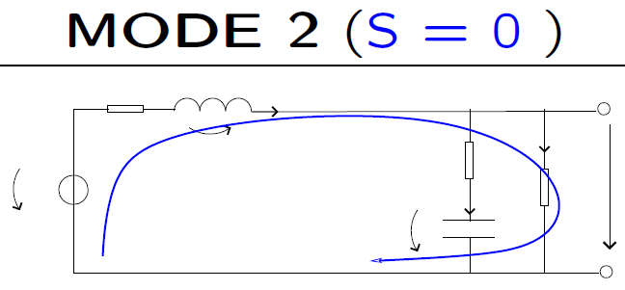
Hybrid system: example
DC-DC converter
Continuous dynamics: states
Discrete events: S=0, S=1

Slide 5
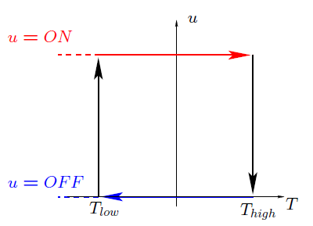
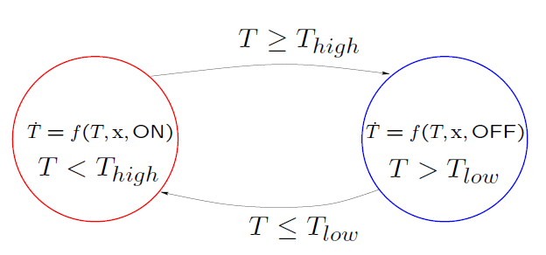
Hybrid system: example
On-Off Temperature Control
Discrete input ⇒ heating u ∈ {ON,OFF}
Continuous dynamics: temperature of the room (state). Evolution regulated by differential equations

Slide 6
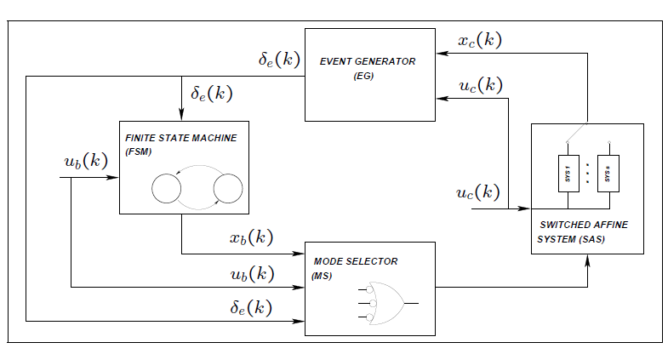
Discrete hybrid automata
Interconnection between:
switched affine system (SAS)
⇒ continuous dynamics
finite state machine (FSM)
⇒ discrete events
Interconnection based on:
Event Generator (EG)
– logic signals from the constraints on continuous states and time
– triggers mode switching of the FSM
Mode Selector (MS)
⇒ selection of an affine subsystem

Slide 7
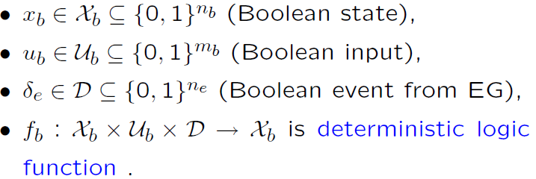
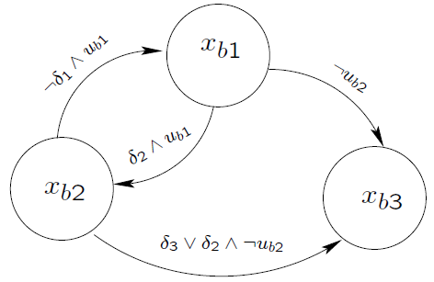
Discrete hybrid automata
Finite State Machine (Automaton)
Discrete time dynamic process:

Slide 8
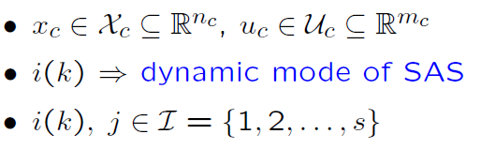
Discrete hybrid automata
Switched Affine System (SAS)
State update equation:

Slide 9

Discrete hybrid automata
Mode Selector (MS)
Boolean function

Slide 10


Discrete hybrid automata
Event Generator(EG)
Defined by function

Slide 11
Control of hybrid systems
Different approaches:
heuristics and ad hoc solutions
systematic and general approach: MPC
In order to use MPC we need a mathematical model that is
descriptive: captures the behavior of the hybrid system
simple (enough) for analysis and the prediction of the states
Discrete Hybrid Automata: good framework for the description of a hybrid system
BUT not convenient for the MPC formulation
How to describe the interaction between continuous dynamics and propositional logic rules ?
Idea: Associate to each Boolean variable pi a binary integer variable δi!

Slide 12


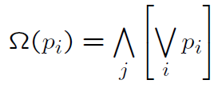
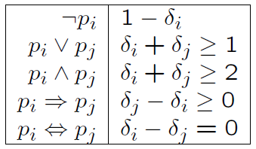
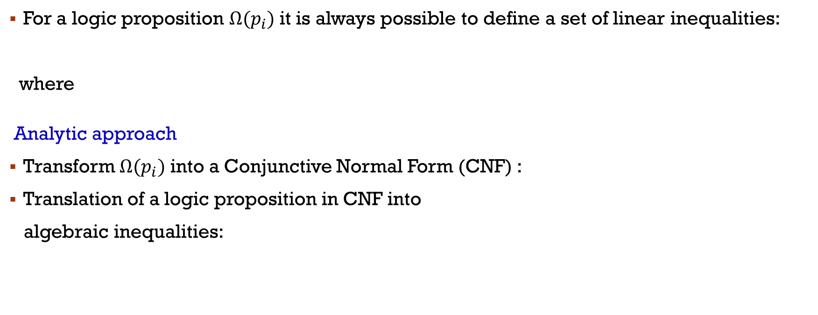
Translation of Logic Rules into Linear Integer Inequalities
For a logic proposition ­$Ω(p_{i})$ it is always possible to define a set of linear inequalities:
where
Analytic approach
Transform $Ω(p_{i})$ into a Conjunctive Normal Form (CNF) :
Translation of a logic proposition in CNF into
algebraic inequalities:

Slide 13


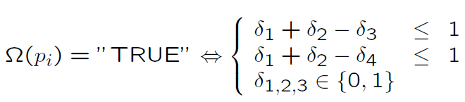
Translation of Logic Rules into Linear Integer Inequalities
Example
Remove implication
using DeMorgan’s theorem, obtain CNF:
Introduce and write the inequalities

Slide 14

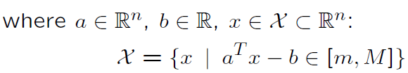


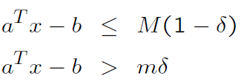
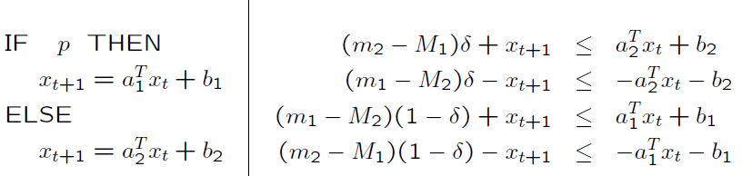
Combining Logic Rules and Continuous Dynamics
Linear inequality as logic condition
Boolean variable p and continuous variable x ∈ R^{n}:
Translated to linear inequalities:

Slide 15






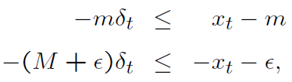
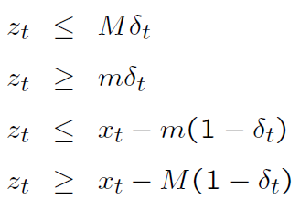

Hybrid modeling
Consider the following system:
with constraints
Associate
State update equation becomes
Introduce disaggregated variable then:
constraints on x: constraints on z:

Slide 16
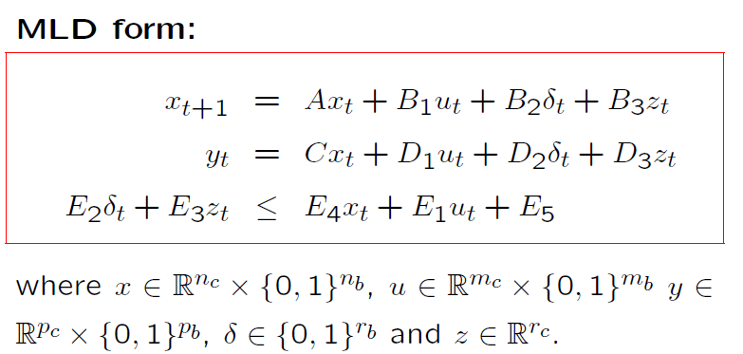
Mixed Logical Dynamical (MLD) Hybrid Model

Slide 17
Mpc for hybrid system
Mixed integer (because of the binaries) LPs and QPs
Complexity strongly depends on the problem structure and the initial setup
In general:
Mixed-Integer programming is HARD
efficient general purpose solvers for MILP/MIQP: CPLEX, XPRESS-MP
⇒ based on Branch-And-Bound , Branch-And-Cut methods + a lot of heuristics
on-line optimization is good for applications allowing large sampling intervals (typically minutes ), requires expensive hardware and (even more) expensive software
for problems requiring fast sampling rate
⇒ explicit solution of the MPC

